Slide 1
SEP561 Embedded Computing
Fall 2004
S. Maeng
KAIST

Slide 2
Syllabus, cont’d
Instructors: Seungryoul Maeng, Room 4403,
maeng@camars.kaist.ac.kr,
Office Hours: M 1-2:30, W 1- 2:30
Class Website:
  http://camars.kaist.ac.kr/~maeng/sep561/ec04.htm
TAs: 최민, 박은지
Course Outline
  Introduction to Embedded computing
  TBD

Slide 3
Syllabus, cont’d
Lab Outline
  하드웨어 직접제어를 통한 주변장치 제어
  Linux Device Driver를 통한 주변장치 제어
  Project
Course Requirements
  Knowledge
    Digital systems, computer architecture (organization), C programming and Operating systems
  Interest
    Strong interest in this fields

Slide 4
Syllabus
Course Grading:
  강의 : 60 %
    시험 : 30%
    기타(숙제, 퀴즈, 강의 출석, 참여도 등) : 30%
  실험 및 프로젝트: 40%
* 모든 부분에서 copy를 할 경우 학점을 "F"로 줄 것임
Reference Books:
  Computers as Components: Principles of Embedded Computing System Design, Wayne Wolf, Morgan Kaufmann.
  Embedded Systems Design : A Unified Hardware/Software Introduction, Vahid, Wiley.
  Embedded Systems: Architecture, Programming and Design, Raj Kamal, Tata McGraw-Hill.
  실험노트
  Selected Papers

Slide 5
Embedded Systems on the Web (by Srivastava)
Berkeley Design technology, Inc.: http://www.bdti.com
EE Times Magazine: http://www.eet.com/
Linux Devices: http://www.linuxdevices.com
Embedded Linux Journal: http://embedded.linuxjournal.com
Embedded.com: http://www.embedded.com/
  Embedded Systems Programming magazine
Circuit Cellar: http://www.circuitcellar.com/
Electronic Design Magazine: http://www.planetee.com/ed/
Electronic Engineering Magazine: http://www2.computeroemonline.com/magazine.html
Integrated System Design Magazine: http://www.isdmag.com/
Sensors Magazine: http://www.sensorsmag.com
Embedded Systems Tutorial: http://www.learn-c.com/
Collections of embedded systems resources
  http://www.ece.utexas.edu/~bevans/courses/ee382c/resources/
  http://www.ece.utexas.edu/~bevans/courses/realtime/resources.html
Newsgroups
  comp.arch.embedded, comp.cad.cadence, comp.cad.synthesis, comp.dsp, comp.realtime, comp.software-eng, comp.speech, and sci.electronics.cad
[Srivastava]

Slide 6
Embedded Systems Courses on the Web (by Srivastava)
Alberto Sangiovanni-Vincentelli @ Berkeley
  EE 249: Design of Embedded Systems: Models, Validation, and Synthesis
    http://www-cad.eecs.berkeley.edu/Respep/Research/classes/ee249/fall01
Brian Evans @ U.T. Austin
  EE382C-9 Embedded Software Systems
    http://www.ece.utexas.edu/~bevans/courses/ee382c/index.html
Edward Lee @ Berkeley
  EE290N: Specification and Modeling of Reactive Real-Time Systems
    http://ptolemy.eecs.berkeley.edu/~eal/ee290n/index.html
Rajesh Gupta @ UCI
  ICS 212: Introduction to Embedded Computer Systems
    http://www.ics.uci.edu/~rgupta/ics212.html
  ICS 213: Software for Embedded Systems
    http://www.ics.uci.edu/~rgupta/ics213.html
[Srivastava]

Slide 7
Introduction
What are embedded systems?
Why do we care?
Trends

Slide 8
Definition
Embedded system: any device that includes a programmable computer but is not itself a general-purpose computer.
Take advantage of application characteristics to optimize the design:
  don’t need all the general-purpose bells and whistles.

Slide 9
Embedding a computer
output
analog
CPU
input
analog
mem
embedded
computer

Slide 10
Examples
Personal digital assistant (PDA).
Printer.
Cell phone.
Automobile: engine, brakes, dash, etc.
Television, Digital TV.
Household appliances-Home network.
PC keyboard (scans keys).

Slide 11
Application examples
Simple control: front panel of microwave oven, etc.
Canon EOS 3 has three microprocessors.
  32-bit RISC CPU runs autofocus and eye control systems.
Analog TV: channel selection, etc.
Digital TV: programmable CPUs + hardwired logic.

Slide 12
Automotive embedded systems
Today’s high-end automobile may have 100 microprocessors:
  4-bit microcontroller checks seat belt;
  microcontrollers run dashboard devices;
  16/32-bit microprocessor controls engine.

Slide 13
BMW 850i brake and stability control system
Anti-lock brake system (ABS): pumps brakes to reduce skidding.
Automatic stability control (ASC+T): controls engine to improve stability.
ABS and ASC+T communicate.
  ABS was introduced first---needed to interface to existing ABS module.

Slide 14
BMW 850i, cont’d.
sensor
sensor
brake
brake
ABS
hydraulic
pump
brake
brake
sensor
sensor

Slide 15
Early history
Late 1940’s: MIT Whirlwind computer was designed for real-time operations.
  Originally designed to control an aircraft simulator.
First microprocessor was Intel 4004 in Feb. 1971 – 4 bit controller: Busicom
Intel 8008, April 1972, Datapoint.
HP-35 calculator used several chips to implement a microprocessor in 1972.

Slide 16
Early history, cont’d.
Automobiles used microprocessor-based engine controllers starting in 1970’s.
  Control fuel/air mixture, engine timing, etc.
  Multiple modes of operation: warm-up, cruise, hill climbing, etc.
  Provides lower emissions, better fuel efficiency.

Slide 17
Why do we care?
Embedded computing a field or just a fad?
  Building embedded systems for decades
  Early microprocessors
    Limited performance -> manage I/O devices
    Assembly languages
  By the early 1980s, 16-bit microprocessors
    Automobile engine controls that relied on sophisticated algorithms (Motorola 68000)
    Numerical method like Kalman filters
    Laser and inkjet printers
  By the early 1990s, cell phones contains five or six DSPs and CPUs
An indicator: where are the CPUs being used?

Slide 18
Where are the CPUs?
Estimated 98% of 8 Billion CPUs produced in 2000 used for embedded apps
Where Are the Processors?
Direct
2%
Robots
6%
Vehicles
12%
8.5B Parts
per Year
Embedded Computers
80%
Look for the CPUs…the Opportunities Will Follow!
Source: DARPA/Intel (Tennenhouse)
[Srivastava]

Slide 19
Why do we care? Cont’d.
Embedded computer HW/SW are on the critical design path for many types of electronic systems
  Modern cars: up to ~100 processors running complex software
    engine & emissions control, stability & traction control, diagnostics, gearless automatic transmission
Problems
  Undersized HW platform : software design difficulties
  Bad SW architecture : SW, Performance, and Power problems
  Underestimating power consumption: reducing the entire system’s effective lifetime

Slide 20
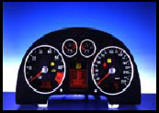
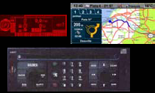
Complexity, Quality, & Time To Market today
 | Instrument Cluster | Telematic Unit
Memory | 184 KB | 8MB
Lines of Code | 45,000 | 300,000
Productivity | 6 Lines/Day | 10 Lines/Day
Change Rate | 1 Year | < 1 Year
Dev. Effort | 30 Man-yr | 200 Man-yr
Validation Time | 2 Months | 2 Months
Time to Market | 12 Months | < 12 Months
*from Sangiovanni-Vincentelli’s lecture notes

Slide 21
Typical Characteristics of Embedded Systems
Part of a larger system
  not a “computer with keyboard, display, etc.”
HW & SW do application-specific function – not G.P.
  application is known a priori
  but definition and development concurrent
Some degree of re-programmability is essential
  flexibility in upgrading, bug fixing, product differentiation, product customization
Interact (sense, manipulate, communicate) with the external world

Slide 22
Typical Characteristics of embedded systems
Never terminate (ideally)
Increasingly high-performance (DSP) & networked
Sophisticated functionality.
  Often have to run sophisticated algorithms or multiple algorithms.
    Cell phone, laser printer.
  Often provide sophisticated user interfaces.

Slide 23
Typical Characteristics of embedded systems
Real-time operation.
  Operation is time constrained: latency, throughput
  Must finish operations by deadlines.
    Hard real time: missing deadline causes failure.
    Soft real time: missing deadline results in degraded performance.
  Many systems are multi-rate: must handle operations at widely varying rates.
Low manufacturing cost.
  Many embedded systems are mass-market items that must have low manufacturing costs.
    Limited memory, microprocessor power, etc.

Slide 24
Typical Characteristics of embedded systems
Low power.
  Power consumption is critical in battery-powered devices.
    Excessive power consumption increases system cost even in wall-powered devices.
size, weight, heat, reliability etc.
Designed to tight deadlines by small teams.

Slide 25
Key Recent Trends
Increasing computation demands
  e.g. multimedia processing in set-top boxes, HDTV
Increasingly networked
  to eliminate host, and remotely monitor/debug
  embedded Web servers
    e.g. Axis camera http://neteye.nesl.ucla.edu
    e.g. Mercedes car with web server
  embedded Java virtual machines
    e.g. Java ring, smart cards, printers
  cameras, disks etc. that sit directly on networks

Slide 26
Key Recent Trends
Increasing need for flexibility
  time-to-market under ever changing standards!
Often designed by a small team of designers.
    Often must meet tight deadlines.
    6 month market window is common.
Need careful co-design of h/w & s/w!

Slide 27
Traditional Embedded Systems and Design
What is the difference?
  Functional complexity
  Hardware trends
  Software trends
Design Methodologies

Slide 28
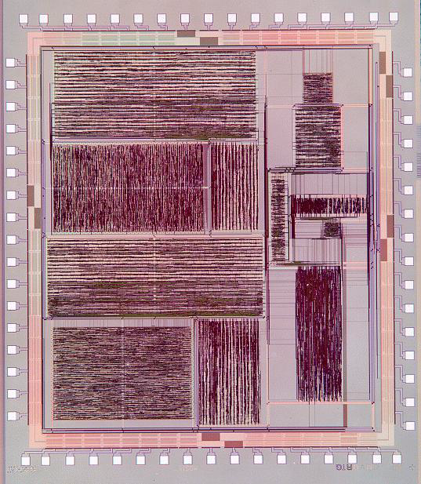
“Traditional” Hardware Embedded Systems = ASIC
ASIC Features
  Area: 4.6 mm x 5.1 mm
  Speed: 20 MHz @ 10 Mcps
  Technology: HP 0.5 μm
  Power: 16 mW - 120 mW (mode dependent) @ 20 MHz, 3.3 V
  Avg. Acquisition Time: 10 μs to 300 μs
A direct sequence spread spectrum (DSSS) receiver ASIC (UCLA)
[Srivastava]

Slide 29
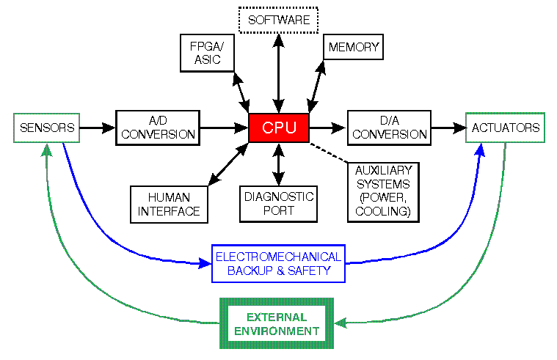
“Traditional” Software Embedded Systems = CPU + RTOS
[Srivastava]

Slide 30
The co-design ladder
In the past:
  Hardware and software design technologies were very different
  Recent maturation of synthesis enables a unified view of hardware and software
SW/HW codesign
Sequential program code (e.g., C, VHDL)
Compilers
(1960's,1970's)
Behavioral synthesis
(1990's)
Register transfers
Assembly instructions
RT synthesis
(1980's, 1990's)
Assemblers, linkers
(1950's, 1960's)
Logic equations / FSM's
Logic synthesis
(1970's, 1980's)
Machine instructions
Logic gates
Implementation
Microprocessor plus program bits: “software”
VLSI, ASIC, or PLD implementation: “hardware”
The choice of hardware versus software for a particular function is simply a tradeoff among various design metrics, like performance, power, size, and especially flexibility; there is no fundamental difference between what hardware or software can implement.

Slide 31
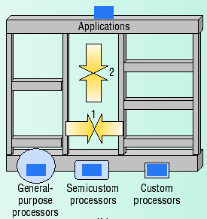
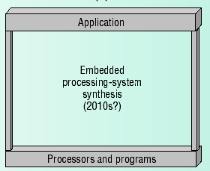
The co-design ladder

Slide 32


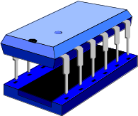
Modern Embedded Systems?
DSP Code
Application Specific Gates
Analog
I/O
Processor Cores
Memory
Embedded systems employ a combination of
  application-specific h/w (boards, ASICs, FPGAs etc.)
    performance, low power
  s/w on prog. processors: DSPs, μcontrollers etc.
    flexibility, complexity
  mechanical transducers and actuators

Slide 33
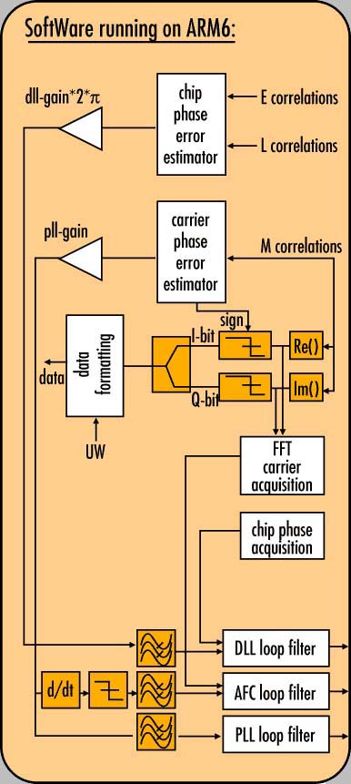
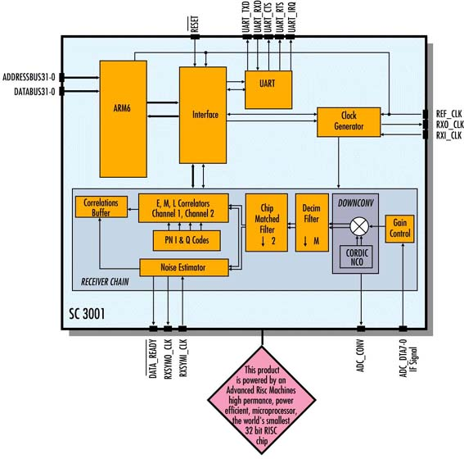
Increasingly on the Same Chip
System-on-Chip (SoC)
[Srivastava]
SC3001 DIRAC chip (Sirius Communications)

Slide 34
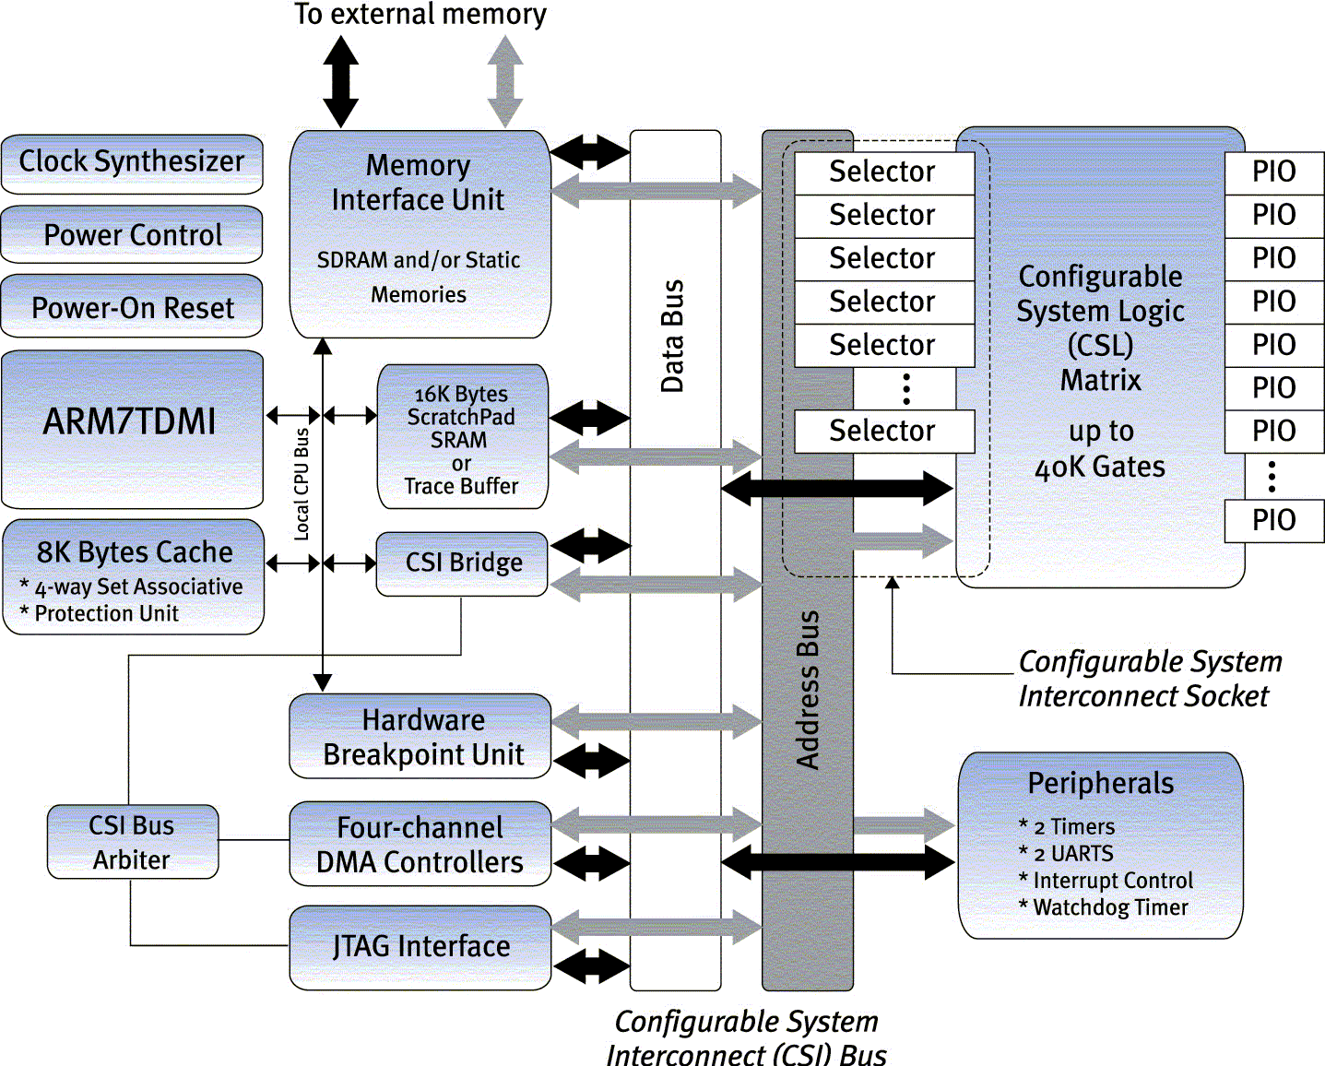
Reconfigurable SoC
Other Examples
Atmel’s FPSLIC
(AVR + FPGA)
Altera’s Nios
(configurable RISC on a PLD)
Triscend’s A7 CSoC
[Srivastava]

Slide 35
Challenges in embedded system design
How much hardware do we need?
  How big is the CPU? Memory?
How do we meet our deadlines?
  Faster hardware or cleverer software?
How do we minimize power?
  Turn off unnecessary logic? Reduce memory accesses?

Slide 36
Challenges, etc.
Does it really work?
  Is the specification correct?
  Does the implementation meet the spec?
  How do we test for real-time characteristics?
  How do we test on real data?

